Slide 1
Insolation and terminations: What is the link? How can we get a better chronology for TII? By Ross Ong and Daniel Babin Paleoceanography Seminar December 02, 2019

Slide 2
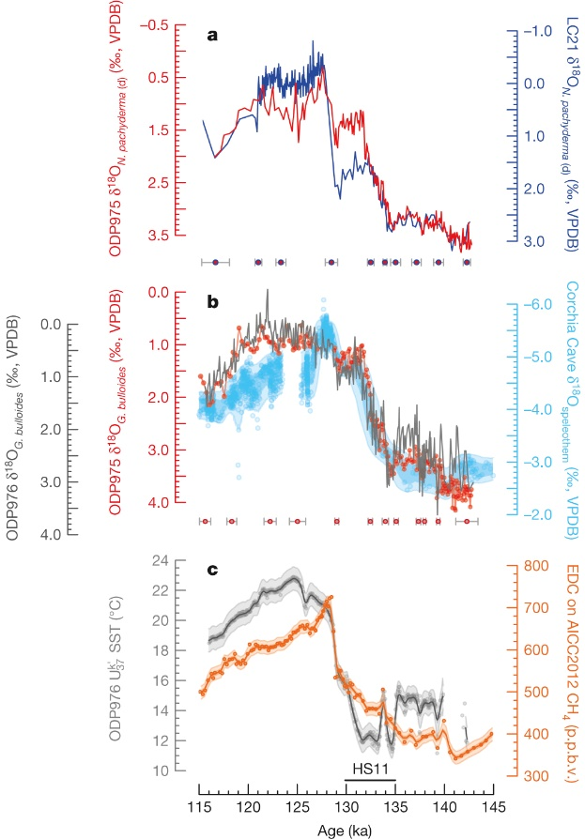
How can get a good chronology?
Marino et al., 2015
Independent radiometrically dated (i.e. U/Th) records compared to other records on the same time scale (as validation)
Tuning (or comparing records) using similar paleo-proxy records (e.g. d18O, N. pachyderma)
Clarified limitations and assumptions and provided uncertainties used their age-modelling process
Tuning records independent of orbital forcing (to avoid the assumption that orbital forcing is what is driving the variability in the proxy record)
Synchronization of western Mediterranean Sea ODP975 to ODP977 and Iberian Margin core MD01-2444.
Construction and validation of a radiometrically constrained
chronology for western Mediterranean Sea ODP975 and ODP976.

Slide 3
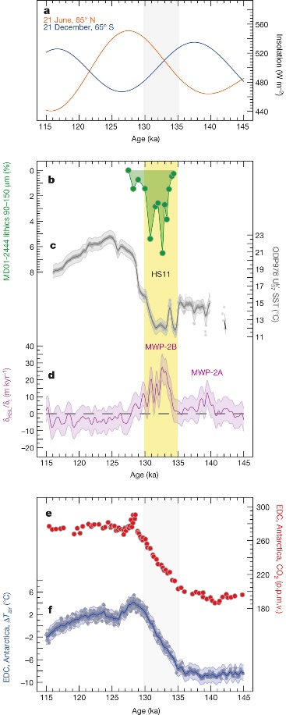
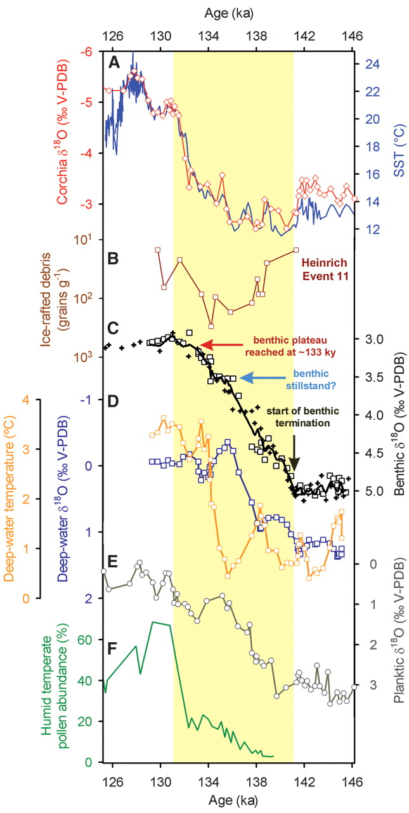
Marino et al. 2015 (left) vs Drysdale et al. 2009 (right)
Differences in age models lead to different interpretations (i.e. HS11 record from MD01-2444).

Slide 4
Summary of the Termination II
Southern hemisphere summer insolation (SHSI) begins to increase (~142 kya) and triggers feedback mechanisms
CO₂ in SH starts to increase (~141kya)
ice melting in SH (MWP-2A, ~139kya)
SHSI peaks, SH temp. begins to rise (~138kya)
N. Hemisphere summer insolation begins to rise (~137kya)
IRDs increases due to NH ice melting (MWP-2B, ~135kya to ~130kya)
FW into ocean causes AMOC to weaken, heat not transported from SH to NH → NH cools, NH SST decreases but, SH temp. is increasing with CO₂ (bipolar seesaw); ITCZ shifts southward (~134 kya, Jacobel et al., 2015)
Pollen % increases (~132kya, signalling start of Eemian, Sanchez-Goni et al 2012)
NHSI continues to increase, NH continues to warm, IRDs starts to decrease (~131kya), less FW into ocean, AMOC reinvigorated, ITCZ possibly starts to shift northward (~129kya, Jacobel et al., 2015)
NH SST is increasing as NHSI increases until NHSI peaks (~128kya)
Enhanced AMOC with sustained NH warm SST (~126kya)
Notes:
SHSI peak consistent with the increase in CO2 in the southern hemisphere
Increasing NHSI, decreasing SHSI consistent with increased IRDs, weakened AMOC, freshening of seawater, increase in sea level
NHSI peak consistent with increase in SST, sustained warming of SH and NH

Slide 5
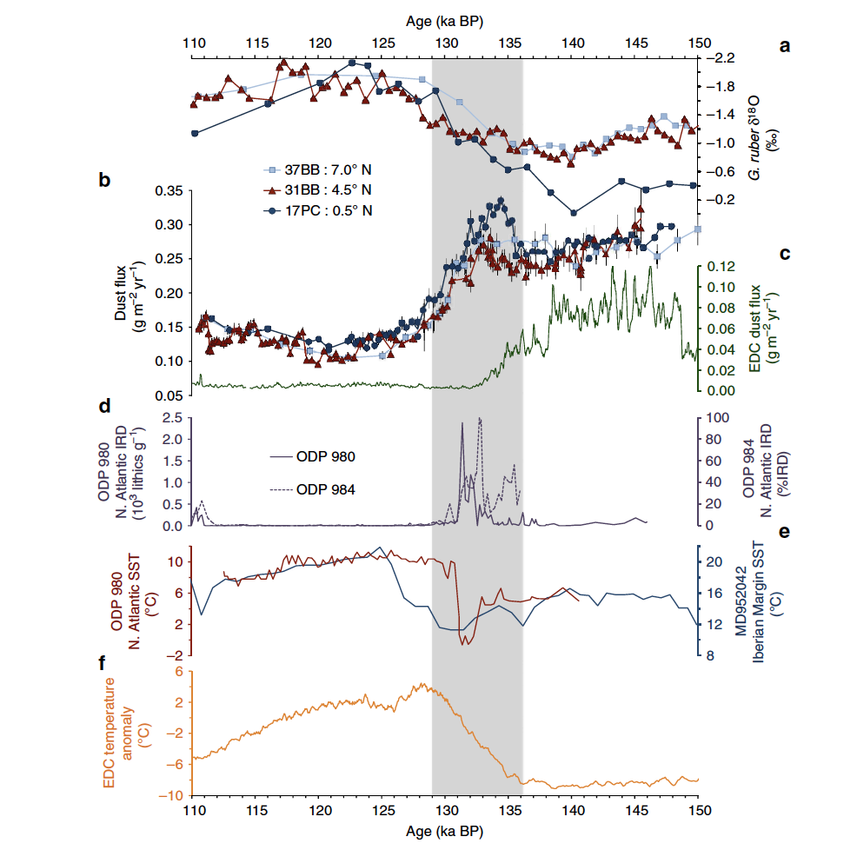
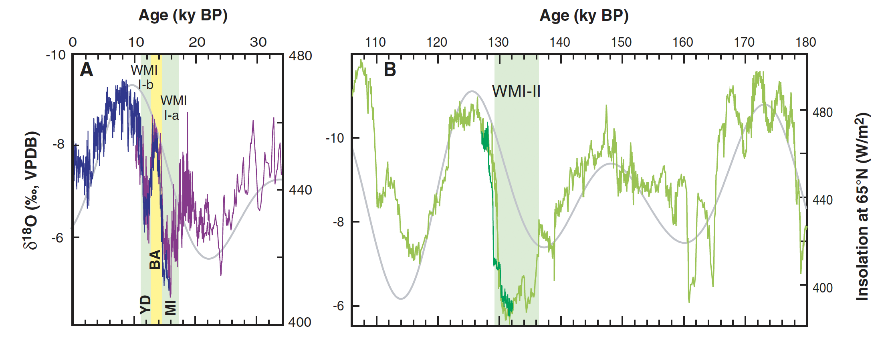
Jacobel et al., 2015
Cheng et al., 2009 (Sanbao cave record)
NHSI peak
SHSI peak
NHSI peak
SHSI peak
Notes:
Cheng et al 2009- d18O records is consistent with the timeline of Marino et al 2015, with the weak monsoon interval happening just right after the SHSI peak saw decrease in d18O from cave records.
Weak monsoon interval is where the IRDs were seen and there was a weakening of the AMOC, hence a more positive d18O from the record, also associated with the southward shift of the ITCZ (resulting in weakened monsoon).
NHSI (June 65N insolation peak) end of WMI, reinvigoration of the AMOC, increased SSTs in the NH.
Jacobel et al 2015, is the record that shows a shift in the ITCZ by at least 4degrees southward and dust fluxes in the equatorial region. Around the time the SHSI peaked, the EDC dust flux decreased.
Around the time the SHSI is decreasing and NHSI increasing, there were IRDs released (HS11) and cooling the NH because of glacial ice melt and ITCZ shifted southwards.
Close to 129kya, before the NHSI peak, the ITCZ may have began shifting northwards again.

Slide 6
What data, record or analysis would be needed to answer this question better? https://github.com/danielbabin/T2_Timing/blob/master/Notebooks/Ice%20Cores.ipynb

Slide 7
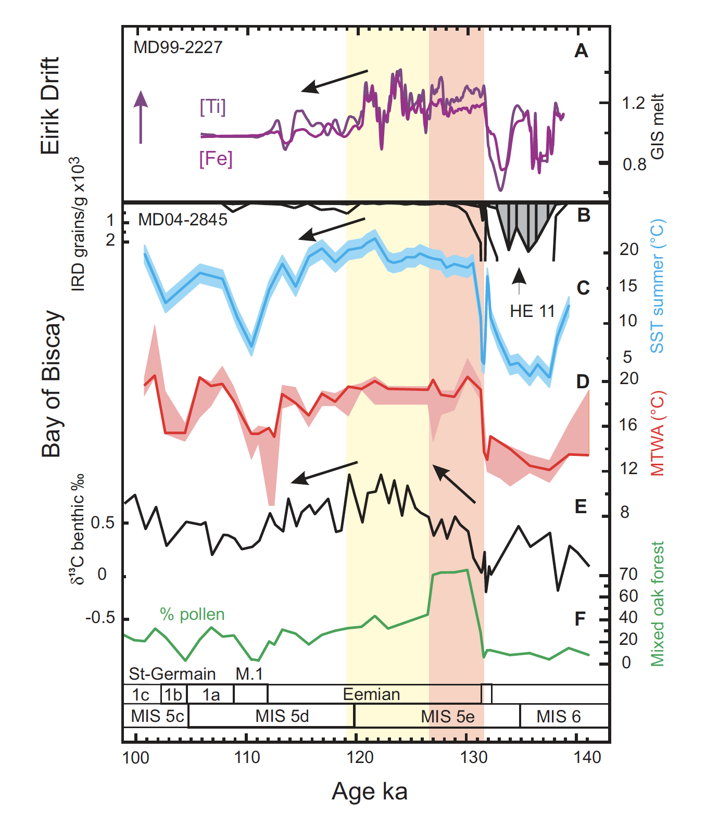
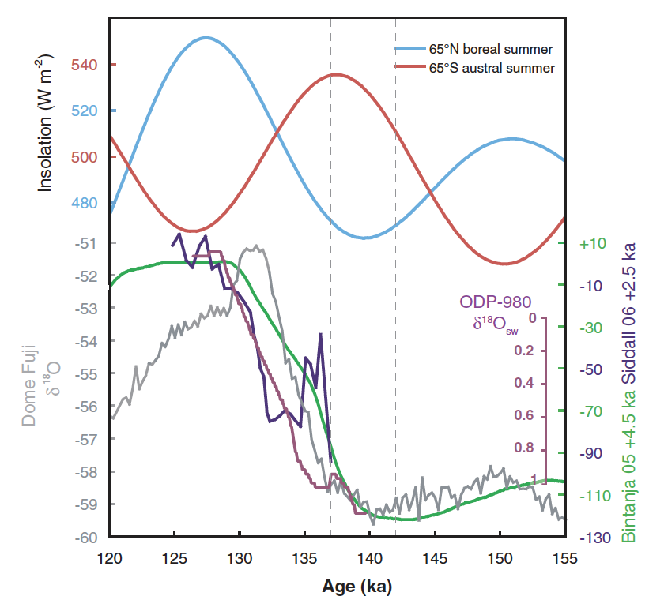
Insolation plays a role in terminations
Thomas et al., 2009
Sanchez-Goni et al., 2012
interval 141–100 ka compared with Greenland Ice Sheet (GIS) melt changes. A: Core MD99–2227: Fe and Ti concentration curves (Carlson et al., 2008). B–F: Multiproxy study of core MD04–2845. B: Icerafted debris (IRD) concentration curve. HE 11 Heinrich event 11. C: Planktonic foraminifera–derived sea-surface temperatures (SST) in summer with error intervals. D: Pollen-derived summer temperatures (MTWA—mean temperature of warmest month) with error intervals. E: Benthic foraminifera δ13C profile. F: Pollen-inferred forest cover changes. Mixed oak forest is mainly composed of deciduous oak, hazel, ash, elm, birch and yew (Fig. DR1 [see footnote 1]). Orange band indicates European climate optimum, strongest GIS melting, and reinvigorating Atlantic meridional overturning circulation; yellow band highlights interval of sustained European warmth and GIS melting, and enhanced deep North Atlantic ventilation. M.1—Mélisey 1 cold phase; MIS—marine isotope stage.
NHSI peak
SHSI peak
Fig. 2. The timing of the penultimate deglacial, illustrated with the data of Bintanja et al. (15) (in green), with the chronology adjusted (+4500 years) to match new coral data of this study (Fig. 1B), and the Red Sea record of Siddall et al. (16) (in dark blue), adjusted by +2500 years. The Dome Fuji ice core d18O (23) and North Atlantic bottom water d18O (22) records are shown for comparison in gray and purple, respectively. Local summer insolation is shown for 65°N (light blue) and 65°S (red) (36). The gray dashed vertical lines are the timing constraints of the deglaciation from Fig. 1B. Note that deglaciation must start when NHI is at or close to a minimum.
NHSI peak
SHSI peak
Notes:
Thomas et al., 2009 showed records of sea level from Bintanja and Dome Fuji d18O. They noted that deglaciation must start close to NHSI minimum. But it can also be noted that SHSI peaked around the time period when deglaciation supposedly started.
Signature of bipolar seesaw can also be seen here.
Sanchez-Goni et al 2012, shows reduced AMOC (d13C record) around the time of the SHSI peak and another reduction at the time when the IRDs were released (HE11), it also showed low GIS melt at the time of AMOC weakening.
Timeline also consistent with the NHSI peak and the reinvigoration of the AMOC after IRDs ceased.
IRD record here is a different from timeline presented in Marino et al 2015.
HS11 from another core, MD04-2845 (different location ,further up north, in contrast to MD01-2444 used in Marino et al 2015), could possibly explain the time shift between the two records.

Slide 8
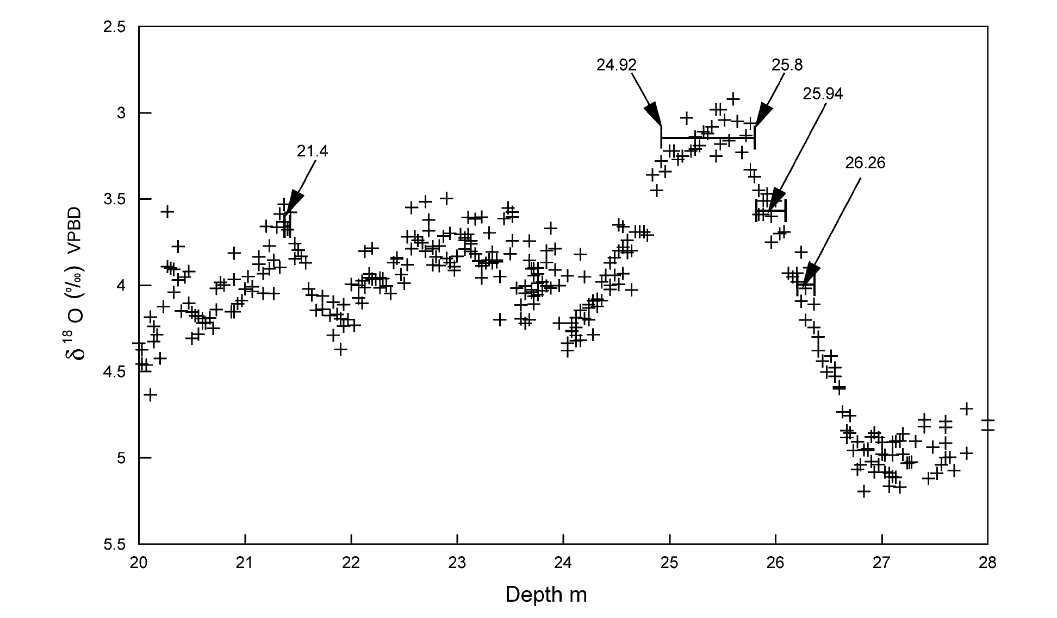
Insolation plays a role in terminations
Shackleton et al., 2003
Enhanced AMOC, sustained NH warm SST, (higher sea level)
Just before obliquity peak (more tilt – warmer summers)
Sea level higher, warmer
Sea level lower, colder
NHSI peak (~128kya)
SHSI peak (~138kya)
Notes:
Based on Shackleton’s chronology of attributing d18O to sea level changes.
Beginning of SHSI peak, start of deglaciation, and the sea level continued to rise until NHSI peak around ~128kya).

